Slide 1


Slide 2
WHY?
Local Plan Demand for Houses
HBO Allocation of 100+ Houses
Sharing the Benefits Concept
No Previous Benefit to HBO
Need for Truly Affordable Homes
Need to Ensure the Sustainability of our Community

Slide 3
WANTS?
HOMES
MONEY

Slide 4
ACHIEVE WANTS?
“To conduct business, discussions, negotiations and activities which benefit the community and in particular (without limitation) to receiving monies, land and other assets from donations, grants, planning and other agreements with third parties with the purpose of using such to benefit the community and infrastructure, including local organisations, local charities, nominated Housing Associations, Hatfield Broad Oak Parish Council and others.”

Slide 5
Parish Council Supported Establishing the Company

Slide 6

STATUS
COMMUNITY INTEREST COMPANY
Approved by the Regulator
Asset Lock
Memorandum of Understanding with Parish Council
COMMUNITY LAND TRUST
Approved Membership of CLT Network
Community Involvement
Locally Driven

Slide 7
COMMUNITY INTEREST COMPANY
COMMUNITY LAND TRUST

Slide 8
COMMUNITY INTEREST COMPANY
Asset Lock
The Company shall not transfer any of its assets other than for the benefit of the community and for other than for full consideration.
Broadoak Community Investments CIC

Slide 9
COMMUNITY INTEREST COMPANY
Community Interest Statement
The Company shall carry on its activities for the benefit of the community of the parish of Hatfield Broad Oak and surrounding parishes where there is a benefit to the community of Hatfield Broad Oak and not for the private benefit of its members
Broadoak Community Investments CIC

Slide 10
COMMUNITY INTEREST COMPANY
Company Objects
The Company is established for the benefit of the community of Hatfield Broad Oak and surrounding parishes, to further the social, economic and environmental interests of that community by conducting business, discussions, negotiations and activities which benefit the community by receiving, acquiring, holding and stewarding land, property, funds and other assets for community benefit
Broadoak Community Investments CIC

Slide 11
COMMUNITY LAND TRUST
The company’s activities will benefit the community of
Hatfield Broad Oak by providing affordable housing in perpetuity
and supporting community facilities and infrastructure.
Broadoak Community Investments CIC

Slide 12
BROADOAK COMMUNITY INVESTMENTS CIC
Company Objects
Provide procure or manage affordable housing for people with a local connection, ensuring such housing remains affordable in perpetuity. Land and housing shall be held in perpetuity for the benefit of the community.
Affordable Housing - Local Lettings Plan - Nominations Process
CLT Recognised by LPAs, RPs, Homes England etc.
Broadoak Community Investments CIC

Slide 13
BROADOAK COMMUNITY INVESTMENTS CIC
Company Objects
Acquire, hold, steward or fund land or buildings for community benefit, including green spaces, community facilities, workspace, heritage assets, or other amenities.
Funds for village community projects.

Slide 14
BROADOAK COMMUNITY INVESTMENTS CIC
Company Objects
Receive, hold, apply and distribute monies, land and other assets from donations, grants, planning agreements (including Section 106 obligations) and other agreements with third parties to support community projects, infrastructure, and local organisations, including (but not limited to) local charities, nominated housing associations,
and Hatfield Broad Oak Parish Council

Slide 15
BROADOAK COMMUNITY INVESTMENTS CIC
Company Objects
Promote projects and services that sustain the well-being, cohesion, heritage and environmental quality of the community.
Enable members of the community to participate in the governance and decision-making of the Company through independently appointed Directors and Hatfield Broad Oak Parish Council’s
membership and representation.

Slide 16
BROADOAK COMMUNITY INVESTMENTS CIC
Company Objects
Make grants or payments to Hatfield Broad Oak Parish Council or other statutory bodies for the purposes of supporting community projects and infrastructure, provided that such grants or payments are applied solely towards the Company’s objects and
not as a distribution of assets to members.

Slide 17
OPTIONS
Parish Council
CIC
CLT
Charitable Incorporated Organisation (CIO)
Community Benefit Society (CBS)

Slide 18
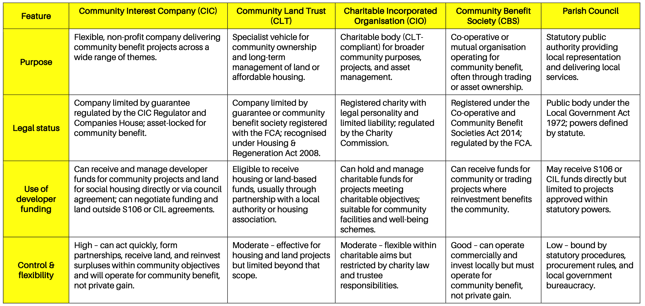
OPTIONS

Slide 19
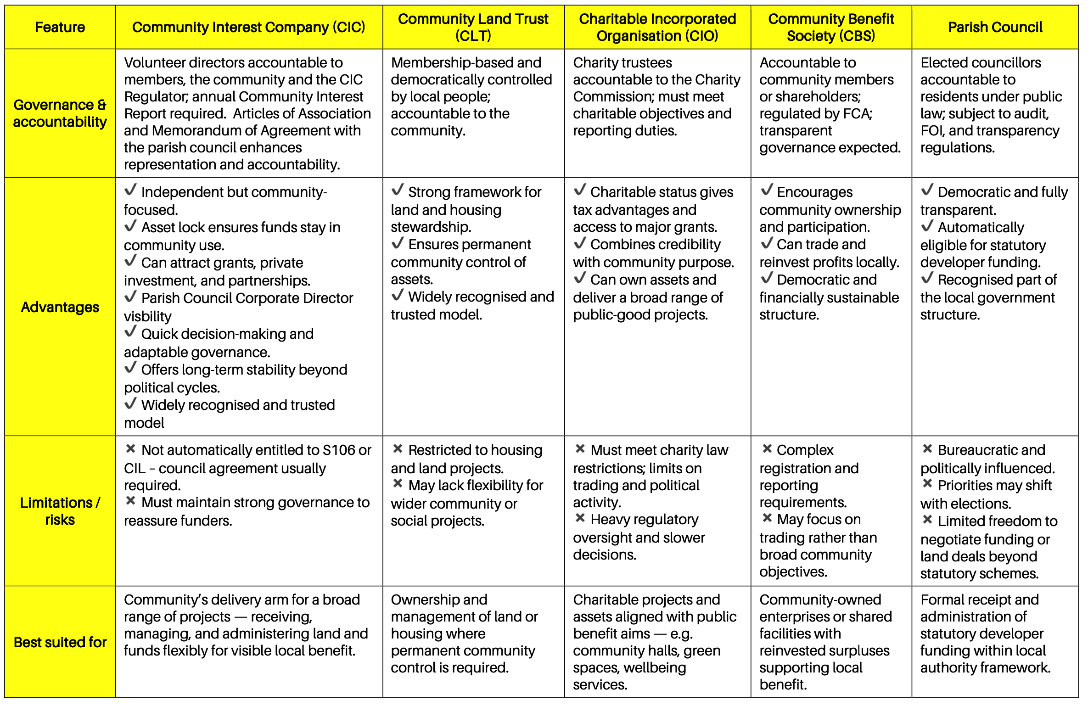
OPTIONS

Slide 20
OPTIONS
The Community Interest Company (CIC) provides the most balanced, flexible, and stable structure for managing developer funding.
It combines independence and long-term accountability with the ability to act swiftly, form partnerships, and deliver results across multiple sectors.
Its asset lock guarantees that community benefit remains central, and its continuity ensures progress and maintains strategic direction.

Slide 21
OPTIONS
Community Land Trusts (CLTs) and Charitable Incorporated Organisations (CIOs) provide secure options for land, housing, and charitable projects, while Community Benefit Societies (CBSs) offer democratic ownership and trading potential.
Parish Councils remain the statutory route for receiving formal Section 106 and CIL funds but are often constrained by bureaucracy, short-term political pressures and limits to funding.

Slide 22
OPTIONS
A CIC operating with the adopted principles of a CLT provides the most effective long-term solution —
combining flexibility, permanence, transparency and accountability.
Under this model, the Parish Council would continue to handle statutory funding, while the CIC could negotiate directly for additional community benefits, land, or developer contributions outside formal agreements. This ensures a consistent, independent pathway of community improvement aligned with local priorities.

Slide 23
RATIONALE
Parish Councils are automatically eligible for statutory developer funding and hence not to be confused or diluted.
Developer funding must not influence parish council
decisions on planning, hence separate.
A CIC/CLT can make grants to parish and community
causes that parish councils cannot.

Slide 24
RATIONALE
Parish Councils are automatically eligible for statutory developer funding and hence not to be confused or diluted.
Developer funding must not influence parish council
decisions on planning, hence separate.
A CIC/CLT can make grants to parish and community
causes that parish councils cannot.

Slide 25
RATIONALE
Parish Councils are automatically eligible for statutory developer funding and hence not to be confused or diluted.
Developer funding must not influence parish council
decisions on planning, hence separate.
A CIC/CLT can make grants to parish and community
causes that parish councils cannot.

Slide 26
RATIONALE
A CLT can hold land for affordable housing.
Decision making more streamlined.
Dedicated sole community aims enshrined
in company articles, asset lock and objectives.
Regulated legal entity, recognised by Government.
Fixed in Law - Not subject to local politics.

Slide 27
RATIONALE
A CLT can hold land for affordable housing.
Decision making more streamlined.
Dedicated sole community aims enshrined
in company articles, asset lock and objectives.
Regulated legal entity, recognised by Government.
Fixed in Law - Not subject to local politics.

Slide 28
RATIONALE
A CLT can hold land for affordable housing.
Decision making more streamlined.
Dedicated sole community aims enshrined
in company articles, asset lock and objectives.
Regulated legal entity, recognised by Government.
Fixed in Law - Not subject to local politics.

Slide 29
RATIONALE
A CLT can hold land for affordable housing.
Decision making more streamlined.
Dedicated sole community aims enshrined.
in company articles, asset lock and objectives.
Regulated legal entity, recognised by Government.
Fixed in Law - Not subject to local politics.

Slide 30
RATIONALE
A CLT can hold land for affordable housing.
Decision making more streamlined.
Dedicated sole community aims enshrined.
in company articles, asset lock and objectives.
Regulated legal entity, recognised by Government.
Fixed in Law - Not subject to local politics.

Slide 31
SOLUTION
CIC Asset Lock
CIC Decision Making
CIC Funds Distribution (less limitations than PC)
CIC Recognised & Regulated by CH Regulator
CIC For Community Benefit Only
CIC Not linked to PC planning decisions

Slide 32
SOLUTION
CLT Recognised in Local & Neighbourhood Plans
CLT Housing and Regeneration Act 2008 (Part 2, 79)
CLT Town and Country Planning Act 1990
CLT NPPF & S106
CLT Homes England
CLT Dpt for Levelling Up, Housing and Communities
CLT LPAs, Reg for Social Housing, CLT Network

Slide 33
INVOLVEMENT
COMMUNITY MEMBERSHIP
COMMUNITY ASSEMBLY
LOCAL HOUSING COMMITTEE
directors@broadoak-community-investments-cic.uk

Slide 34
PAUSE
Any questions or comments for the directors
on what you’ve heard so far?
Next will update you on what we have done.
Additional Open Floor at end.

Slide 35
RESULTS
Community Development Partnership Agreement (MoU)
English Rural & RCCE
Developer(s)
LLPM & Nomination Agreement
Uttlesford

Slide 36
RESULTS
Community Development Partnership Agreement (MoU)
English Rural & RCCE
Developers
LLPM & Nomination Agreement
Uttlesford
Affordable Homes – 10 from Durkan / Broad Family Scheme

Slide 37
RESULTS
Community Development Partnership Agreement (MoU)
English Rural & RCCE
Developers
LLPM & Nomination Agreement
Uttlesford
Affordable Homes – 10 from Durkan / Broad Family Scheme
£500,000 Contribution from Durkan / Broad Family Scheme

Slide 38
RESULTS
Projects Identified:
Provide new playground equipment, Technology support for St Mary’s School,
Drainage or gulley clearance for the parish,
Restoration projects such as the church tower, scout hut, village sign, or heritage assets, Seed-fund sports and recreation facilities, such as tennis courts, sports pavilion, outdoor community areas, Infrastructure projects such as new speed signs, defibrillators, Support community groups and events such as the Friday Club (seniors), village festival, or local sports clubs.
SUGGESTIONS AND NEEDS INVITED

Slide 39
Open Floor
FURTHER QUESTIONS
COMMENTS
SUGGESTIONS

Slide 40
TRUST AND SUPPORT
directors@broadoak-community-investments-cic.uk

